Slide 1
Tourism Marketing for small businesses
Chapter 14
Tourism Marketing Performance Measurement

Slide 2
Chapter learning aims
To enhance your understanding of:
the need for clear marketing performance indicators
approaches for evaluating the effectiveness of promotions
consumer-based brand equity as an indicator of branding performance over time

Slide 3
Key terms
Performance measurement
Evaluation of the extent to which an objective has been achieved.
Marketing performance indicators
Measurable markers used to evaluate effectiveness in achieving marketing objectives.
Consumer-based brand equity (CBBE)
A model for measuring the strength of a brand in consumers’ minds, over time, which analyses brand salience, brand image and brand loyalty.

Slide 4
Marketing performance measurement
Effective marketing performance measurement is essential for small tourism businesses
  Competing with relatively small promotional budgets
  Promotional spending must be monitored for effectiveness to ensure efficient and best use of resources
While the ultimate marketing performance indicator is sales, there is a range of other quantitative and qualitative markers used to measure the outcomes of promotions, relative to the objectives
Performance measurement can be quite complex, with the greatest challenge being to quantify the direct impact of different promotions on sales

Slide 5
To recap: Marketing planning
Where are we now? (Situation analysis)
Where do we want to go? (Objective setting)
How do we get there? (Implementation of tactics)
How will be know we got there? (Performance measurement)

Slide 6
Evaluating effectiveness of promotion
What is the marketing objective aligned with the promotion?
What is the current level of performance, in relation to the marketing objective?
What performance indicator(s) will be used to evaluate success?

Slide 7
Table 14.1 – Key marketing performance indicators
 | Quantitative | Qualitative
Tracked through the business’ data | Sales volume Sales value Yield Cost per enquiry Visitor numbers Length of stay Repeat visitation levels Occupancy rates Revenue per room Customer satisfaction scores Coupon/special code conversions Numbers of consumer enquiries Number of complaints Website metrics Social media metrics Email signups | Customer feedback comments Digital and social media comments

Slide 8
Table 14.1 – Key marketing performance indicators
Tracked through marketing research | Equivalent advertising value (EAV) of media publicity Advertising recall Brand awareness Brand image Brand loyalty | Consumer perceptions Travel trade perceptions Customer satisfaction Media editorial content Digital and social media comments

Slide 9
Evaluating advertising
Not widely reported in the tourism literature
Difficult
  Eg we know half of our advertising is working…we just don’t know which half
Tracking the number of enquiries within a given time period
Estimating the cost per enquiry
Conversion studies
Surveying the level of advertising recall and purchase intent

Slide 10
Evaluating PR and publicity seeking
Most common is estimating the equivalent advertising value (EAV)
EAV is a measure of what the published media editorial space would cost if purchased as an advertisement
EAV can be applied to all traditional forms of media, such as newspapers, television and radio

Slide 11
EAV limitations
While EAV is easy to measure, and can be an impressive metric to share with stakeholders, there are limitations. For example, EAV does not indicate:
  the content of the editorial
  the extent to which the editorial was positive
  how many of the audience noticed and paid attention to the story
  the extent to which the audience who did pay attention to the editorial represent the target market
  any resultant consumer action as a result of the editorial

Slide 12
Evaluating digital and social media
Common KPIs:
  Counts, completions, page visits, shares, tweets, posts, time spent, viewable impressions, cost per mile (CPM), cost per click (CPC), click through rate (CTR)
However these are not always related to sales eg vanity metrics
  What is the related objective?
  Does the metric help decision making?
Social media listening platforms
  Facebook Analytics
  Google Analytics
  YouTube audience reports

Slide 13
Evaluating sales promotions
Since these are short term sales incentives, effectiveness is easy to monitor:
  The number of enquiries during the promotion period
  The number of sales coupons redeemed
  The cost per redeemed coupon
  Ratio of total costs relative to total redeemed coupon sales

Slide 14
Evaluating trade and consumer expos
Trade contacts made can be contacted for feedback and sales pitches
Sales from distribution channels easy to track
Consumer expos are more challenging to evaluate
  the number of sales leads generated
  the number of promotional coupons with discount codes redeemed
  the ratio of total costs relative to total redeemed coupon sales
  the use of a competition can generate consumer contact details, for follow up contact, and for inclusion in a direct mail database

Slide 15
Measuring branding performance
Consumer-based brand equity (CBBE)
  The power of the brand lies in the minds of consumers
CBBE provides measures of past marketing performance and indicators of possible future performance
Underpins the financial valuation of brand equity, an intangible asset value on the balance sheet
  Valuation of the business

Slide 16
Table 14.2 – CBBE dimensions relative to marketing objectives
CBBE dimension | Marketing objective
Brand salience | To increase awareness of the brand
Brand image | To increase interest in the brand To educate the market about our offerings
Brand loyalty | To increase visitation To increase revisitation

Slide 17
Figure 14.1 – Importance-performance analysis

Slide 18
Monitoring visitor satisfaction
Increased customer satisfaction leads to increased financial performance
Monitoring third party sites eg TripAdvisor
Guests can be asked on-site, and via (e)mail surveys
  SERVQUAL is a ready made 22 item questionnaire
  Based on expectancy-disconfirmation theory
  Gap analysis of SERVQUAL visually highlights gaps between guests’ expectations and perceptions of performance

Slide 19
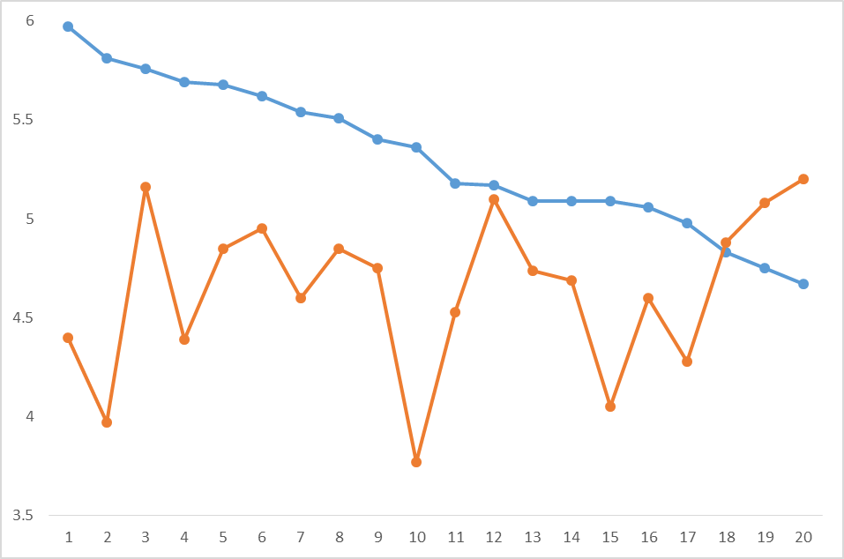
Figure 14.2 – Gap analysis

Slide 20
Discussion questions
The chapter shared an old marketing adage: We know half of our advertising is working…we just don’t know which half. Why is it so challenging to quantify the direct contribution of the entire promotion mix to sales?
Why is performance measurement part of a cycle rather than the end point of marketing planning?
Why is CBBE considered to provide an indicator of future performance?

